Slide 1

Sesi 14 at the restaurant and learning about prepositions
ENGLISH TEAM

Slide 2
LEARNING OBJECTIVES
After learning this session
Able to understand about concept of vocabulary from the conversation at the restaurant and types of prepositions

Slide 3
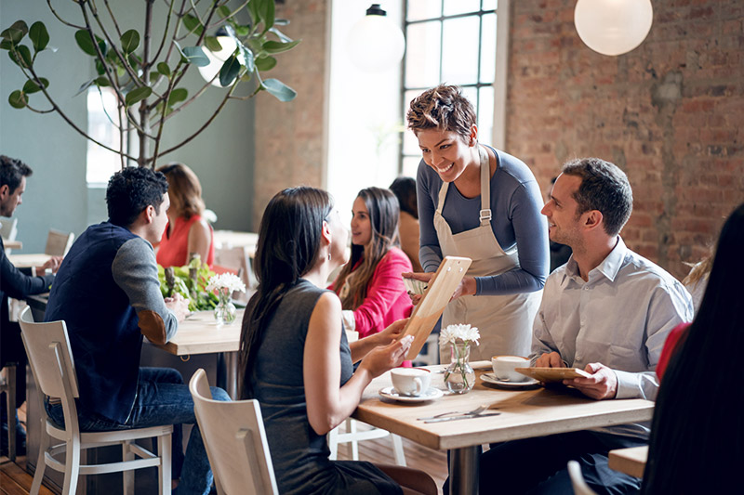
Conversation at the restaurant
https://www.youtube.com/watch?v=bgfdqVmVjfk&t=42s

Slide 4
What is conversation?
Conversation is an exchange of thoughts and ideas between two or more people
Conversation is a communication by two or more people, or sometimes with one’s self, on a particular topic
A conversation occurs when people cooperate with each other in order to introduce and sustain a single focus of attention by taking turns with each other

Slide 5
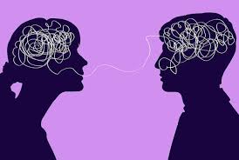

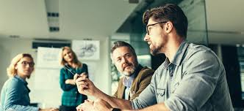
Conversation is communication.
Here are the example of importance communications:
Express thought ideas and feelings
Creating awareness
To fulfill a goal
Avoid isolated
Highlight issues
progress, development
Educating, the masses

Slide 6
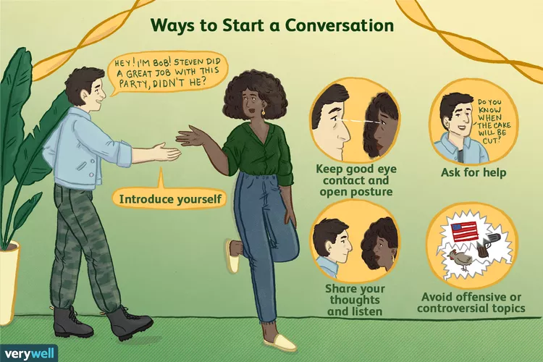

Slide 7
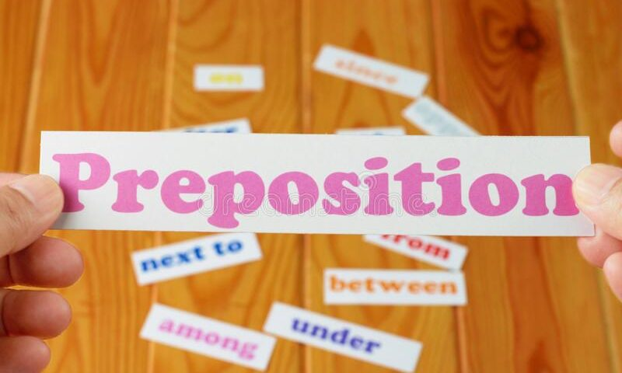

Slide 8
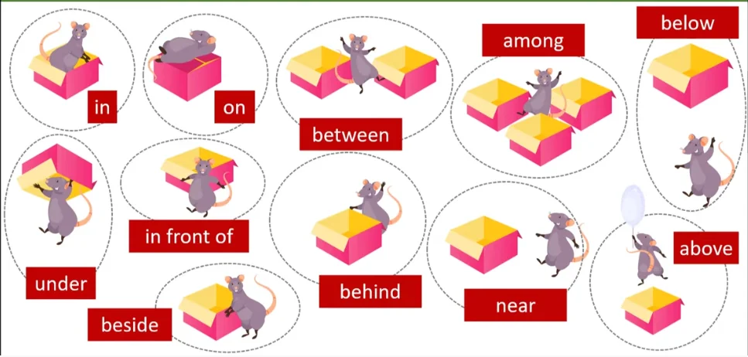
What is preposition ?
A preposition is a word or group of words used before a noun, pronoun, or noun phrase to show direction, time, place, location, spatial relationships, or to introduce an object.

Slide 9
TYPES OF PREPOSITION
Name of preposition | Meaning | Examples | Sentences
Preposition of time | Used to shows when something happens | By, for, until, at | She always brushes her teeth at night
Preposition of direction | Used to shows where something is going | after, down, along, right, towards | A man was walking his dog along the riverbank
Preposition of place | Used to show the position or location of one thing in the relation to another | On, in, behind, below, between, in front of | The pencil is between the two books

Slide 10
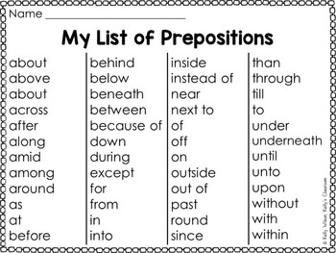

Slide 11
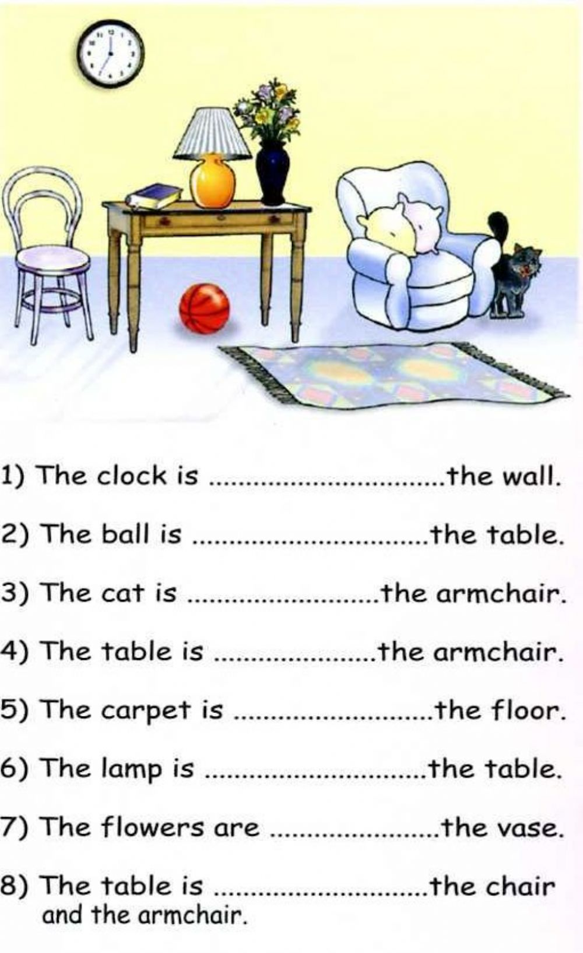
EXERCISE

Slide 12
Conclusion
You will feel more comfortable using articles and the prepositions in, on and at in your writing
Learned that a preposition is often a good word to end a sentence with. Finally, we learned that words serving as prepositions can often serve as other parts of speech as well.
Exercise. https://www.youtube.com/watch?v=Fbcimg1r1Ms

Slide 13


